Slide 1
Understanding District Finance
Christy Jones, executive assistant

Slide 2
Proposed annual budgets
Department Headquarters has designed a budget template format for the Districts use. This format has been designed so that there will be consistency among the Districts. (A copy is enclosed for your use)
Proposed Budgets are due to Department Headquarters by June 5th.
All proposed budgets will be voted on at the annual Department Convention.
If a proposed budget wasn’t approved the District will have to submit a corrected copy before any vouchers can be paid.

Slide 3
Proposed district budget worksheet
See Example 1 located in your packet

Slide 4
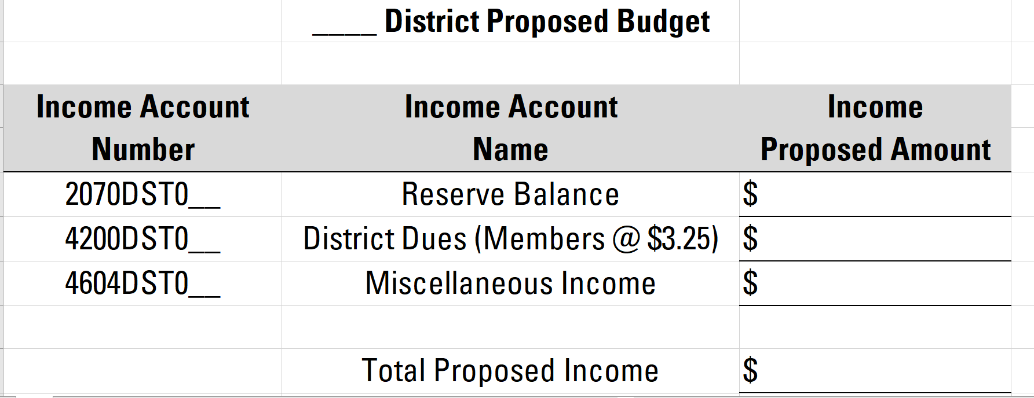
Reserve balances – 2070 dst0xx
If required and voted upon Districts may use part of their reserve balances.
Minutes of said meeting must be attached to the proposed budget with exact reserve amount to be used.

Slide 5
District dues – 4200dst0xx
This amount can be calculated by using the total number of members paid multiplied by $3.25 per member.
This number can be found on the Department Membership Report. Please see example 2 in your packet

Slide 6
As you can see the 11th District has 463 members. To calculate their District Dues for the Budget they will take 463 x $3.25. This will give them $1,504.75
 |  |  | District Standings
Dist | New | PUFL | Reg | HQ Trans | Total | Goal | Percent
11th | 9 | 86 | 368 | 0 | 463 | 771 | 60.05%
12th | 41 | 416 | 988 | 2 | 1447 | 2526 | 57.28%
13th | 10 | 62 | 311 | 0 | 383 | 680 | 56.32%
14th | 4 | 73 | 279 | 0 | 356 | 561 | 63.46%
15th | 12 | 126 | 267 | 0 | 405 | 856 | 47.31%
21st | 32 | 272 | 952 | 6 | 1262 | 2433 | 51.87%
22nd | 1 | 57 | 71 | 1 | 130 | 401 | 32.42%
23rd | 11 | 46 | 313 | 4 | 374 | 659 | 56.75%
24th | 13 | 107 | 201 | 1 | 322 | 753 | 42.76%
31st | 6 | 26 | 192 | 0 | 224 | 429 | 52.21%
32nd | 17 | 144 | 452 | 2 | 615 | 1144 | 53.76%
33rd | 81 | 366 | 993 | 4 | 1444 | 2769 | 52.15%
34th | 5 | 29 | 121 | 0 | 155 | 239 | 64.85%
35th | 11 | 117 | 355 | 1 | 484 | 869 | 55.70%
Total | 253 | 1927 | 5863 | 21 | 8064 | 15090 | 53.44%
 | 11th District Proposed 2022-2023 Budget
Income Account | Income Account | Income
Number | Name | Proposed Amount
2070DST011 | Reserve Balance
4200DST011 | District Dues (Members @ $3.25) | $1,504.75
4604DST011 | Miscellaneous Income
 | Total Proposed Income | $1,504.75

Slide 7
Miscellaneous income 4604dst0xx
Some Districts hold fundraisers. This proposed income should be placed here. Examples are: The 33rd District held a Dudes with Boobs fundraiser.

Slide 8
Total proposed income
 | 11th District Proposed 2022-2023 Budget
Income Account | Income Account | Income
Number | Name | Proposed Amount
2070DST011 | Reserve Balance
4200DST011 | District Dues (Members @ $3.25) | $1,504.75
4604DST011 | Miscellaneous Income
 | Total Proposed Income | $1,504.75
This number is the Total of the Requested Reserve amount, District Dues, and Miscellaneous Income.
For the Example we are using total proposed income of $1,504.75

Slide 9
Proposed expenses
When you are entering your expenses on the budget worksheet. Please pay attention to what has been spent in previous years.
If needed these figures can be provided
We have provided in the worksheet accounts that can be used by your District.
Number | Name | Expense Amount
5100DST011 | Commander | $404.75
5101DST011 | Vice Commander | $100.00
5102DST011 | Adjutant | $400.00
5103DST011 | DEC | $400.00
5104DST011 | Chaplain | $100.00
5105DST011 | Sgt At Arms | $50.00
5106DST011 | Judge Advocate | $50.00

Slide 10
Total Proposed Income | $ 1,504.75
Total Proposed Expenses | $ 1,504.75
Balance | $ -
There maybe line items on here that your district doesn’t budget for so just put a zero there.
Your Proposed expenses should balance with your proposed income.
A balanced budget is a must when you submit your annual budget to Department Headquarters for approval.

Slide 11
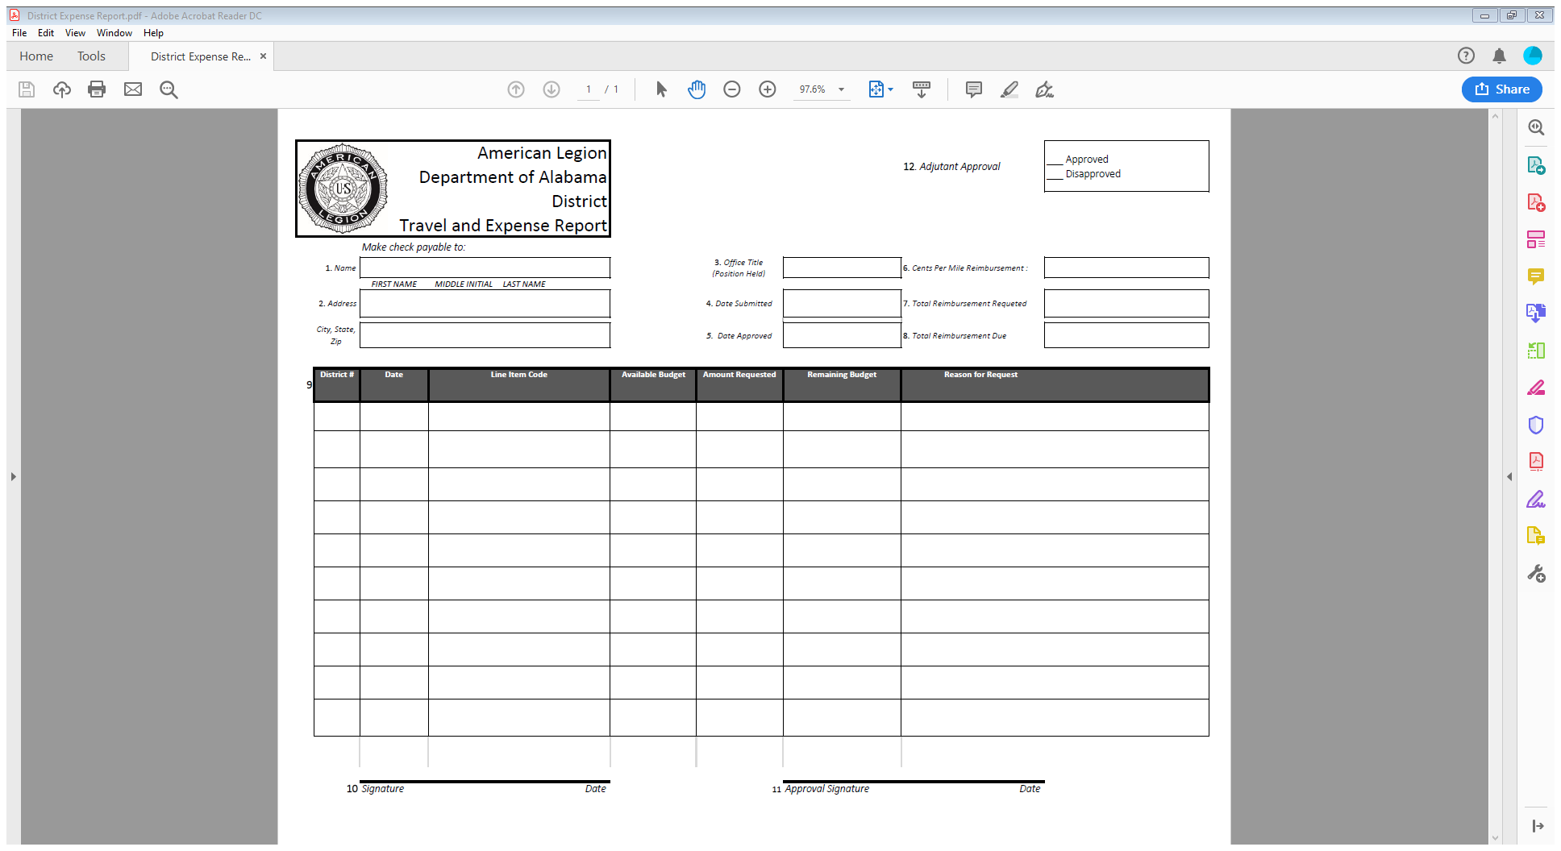
Processing expense vouchers
Please see Example 3 provided in your packet.

Slide 12
Expense report instructions
BLOCKS | INSTRUCTIONS
1 | The name area is for whom the check is to be written
2 | Address the check is to be mailed to
3 | Office title of the individual seeking reimbursement
4 | Date Submitted
5 | Date(s) the travel was approved
6 | Per mile reimbursement $.30 – Please attach MapQuest verification
7 | Total reimbursement requested (completed by person submitting report)
8 | Total reimbursement due
9 | Detail break down of expenses and receipts listed in chronological order
10 | Signature of person submitting reimbursement report
11 | Signature of the approving authority for expenditure. Department needs a list of who has authority to approve vouchers. Before you leave today, please provide me with this list.
12 | Adjutant's approval, initials after review

Slide 13
Submitting expense voucher
Make sure Vouchers are filled out correctly and documentation is attached.
Expense account numbers are listed on the voucher. These account numbers can be found on the Proposed Budget Worksheet. Ex: Commander’s Travel 5100DST011. The account numbers will be the same for all Districts except the last two digits. These two digits should be your District Number.
Make sure that it has been approved by the District Commander or Finance Officer. If voucher has not been approved, it will delay payment.
ALL vouchers should be submitted no later than 30 days from completion of travel.
Vouchers maybe submitted after the 30-day deadline; however, it must be brought up at District meeting for approval and those minutes attached to the expense report.
Approval authority can approve all vouchers except their own.
Expense reports can be submitted by either of the below ways.
Email: bookkeeper@legional.org
Fax: 334-262-9694
Mai: P O Box 1069, Montgomery, Alabama 36101

Slide 14
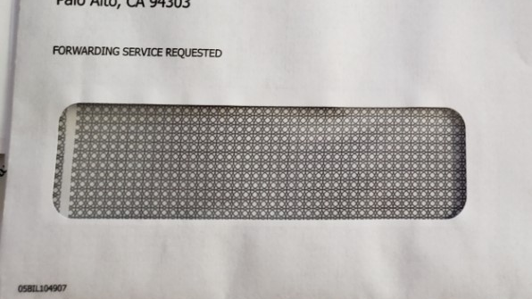
Payment procedures at department headquarters
All expense reports that are received by Wednesday of each week will be entered for that week’s reimbursements. If received after Wednesday, they will be entered the following week.
The Department Adjutant shall review/approve/disapprove all District Expense Vouchers every Thursday of the week.
The Department Finance Officer shall review/approve/disapprove all District Expense Vouchers every Friday of the week
Payments will be mailed the following Monday. Please be on the lookout these payments come from a Company called Payment Operations and may look like junk mail. The envelope will have payment enclosed on the outside. See below

Slide 15
Understanding monthly budget reports
Monthly reports will be produced on/about the 15th of each month.
District Commander’s will provide a list of names that they would like to receive these reports monthly
Please see Example 4 provided in your packet.

Slide 16
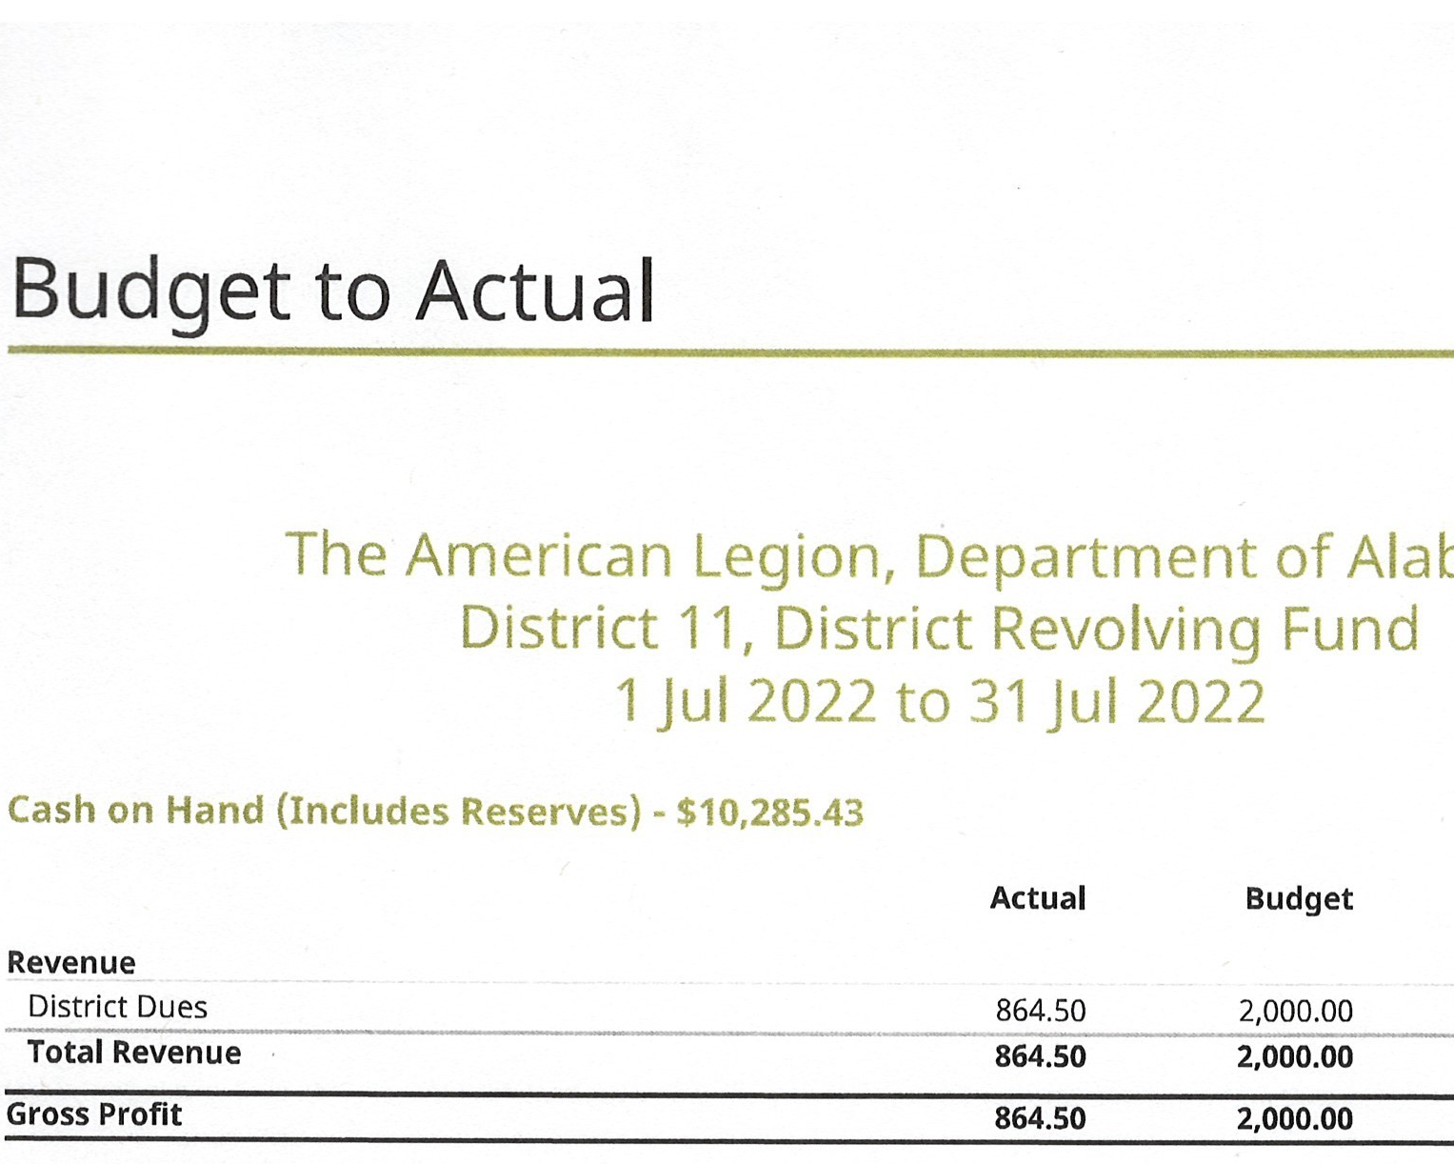
DISTRICT RESERVE BALANCE
This number is your balance as of the Report. As you can see in the report the 11th District has $10,285.43 as of the July 31st report. This number will be carried over each month.

Slide 17
REVENUE SECTION
Actual number – This is what the District has received. As you can see above. The District received $864.20 as of July 31, 2022
Budget number – This is what the District budgeted for the year. The 11th District Budgeted $2,000.00 for the 2022/2023 year.
Var USD – If this number is RED that means a shortage. If it is GREEN this means, there is an overage. As you can see in the about reference report the number is RED. 11th has a shortage of $1,135.50 from what they received versus what they budgeted.
Var % - If this number is RED then that means a shortage. If it is GREEN this will mean, there is an overage. As you can see in the about reference report the number is RED. District is short -56.8% shortage from what they received versus what they budgeted.

Slide 18
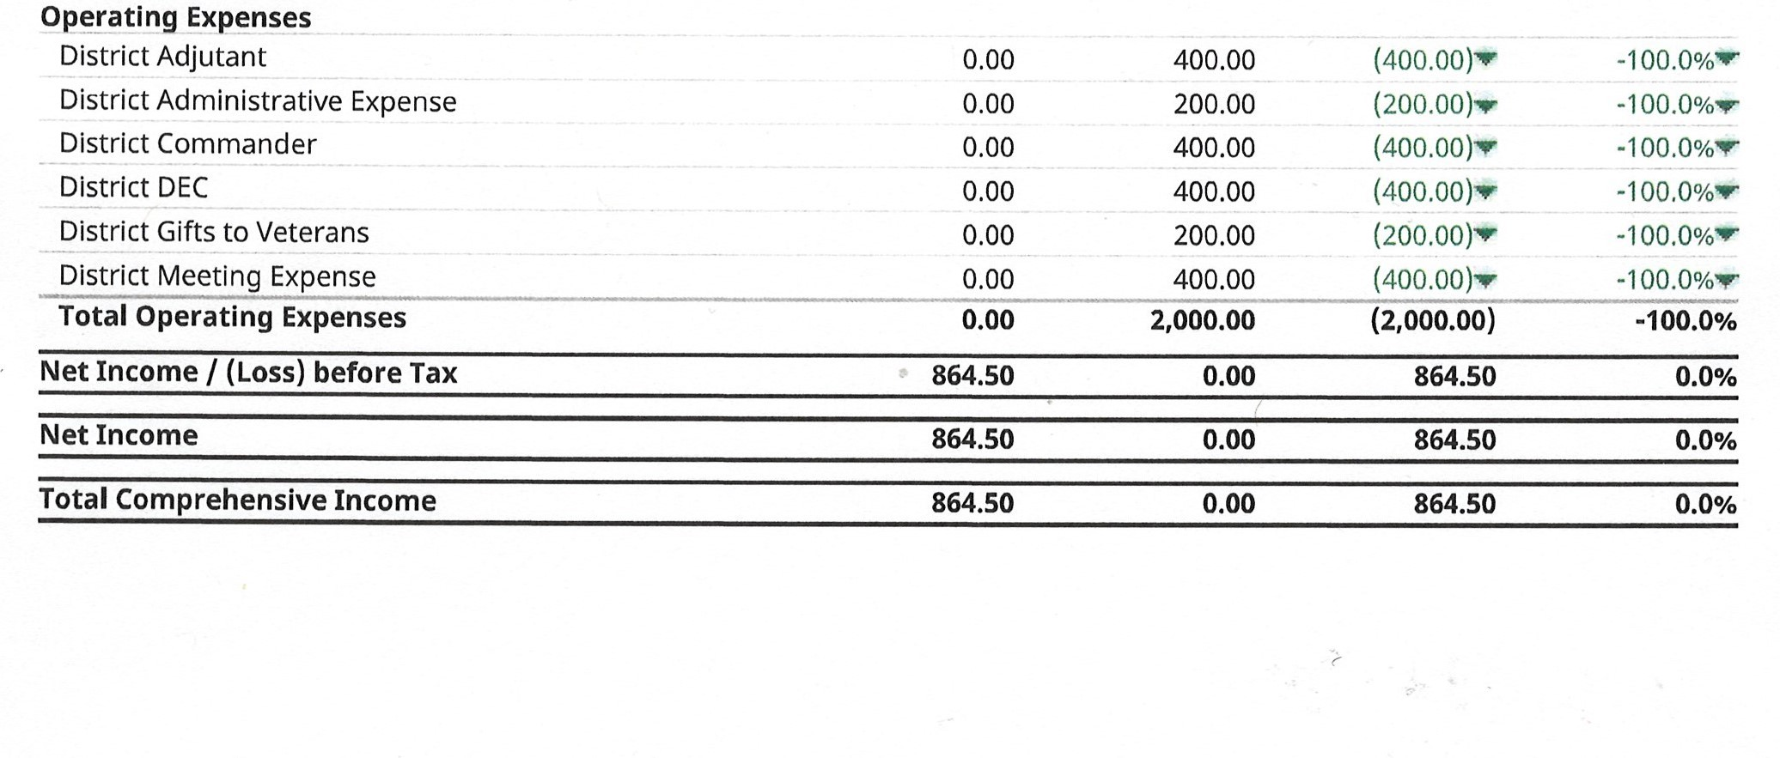
EXPENSES
Actual number – This is what the District has spent. As you can see above. The District has not spent anything as of July 31st.
Budget number – This is what the District budgeted for the year. The 11th District Budgeted 2,000.00 for the 2022-2023 year.
Var USD – If this number is RED then that means they overspent on that line item. If it is GREEN this will mean, they didn’t spend everything they budgeted for the year.
Var % - If this number is RED then that means the District overspent for that line item. If it is GREEN this will mean, that they underspent. As you can see in the about reference report the number is GREEN.

Slide 19
Net Income/(loss before tax, net income, and total comprehensive income
All these numbers in each column is the Sum of Revenue minus Expenses. As you can see 11th District is to the good. They Received more income than they expensed out for July. They have $864.50.
What happens if this number is in the negative? Well, this will be deducted from the District Reserve balance here at Department Headquarters.
What happens if this number is in the positive? This number will be added to the District Reserve Balance.

Slide 20
Questions

